Slide 1
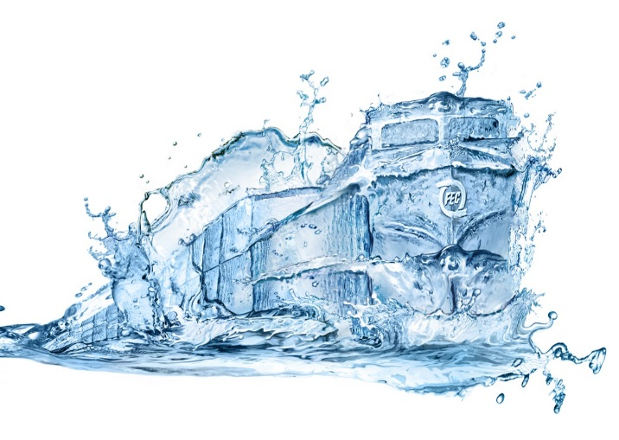
Port Everglades
Florida East Coast Railway
Intermodal Container Transfer Facility
Communications Plan
SPECIAL EVENT

